Slide 1


Pressure Drop Estimation in Pipelines
(Analytical Modeling and Validation using MATLAB, Python, Excel, Aspen HYSYS & DWSIM)
KAVINRAJA CHAKRAVARTHY
Kavinraja Chakravarthy

Slide 2
Agenda
Problem Statement
Fluid Mechanics Fundamentals
Darcy–Weisbach Equation
Flow Regimes & Friction Factor Models
Pipeline Roughness & Material Selection
Minor Losses
Validation with Moody Chart
Engineering Methodology & Workflow
Demo Outputs (Python, Matlab, Excel, DWSIM, Aspen Hysys)
Limitations
Summary
KAVINRAJA CHAKRAVARTHY
Kavinraja Chakravarthy

Slide 3
Problem Statement
Objective: Develop and validate a computational model to estimate pressure drop in pipelines under different flow and material conditions.
Engineering Value:
Enables quick estimation before simulation
Useful for pump sizing
Reduces energy consumption
Helps avoid undersizing/oversizing during design
KAVINRAJA CHAKRAVARTHY
Kavinraja Chakravarthy

Slide 4
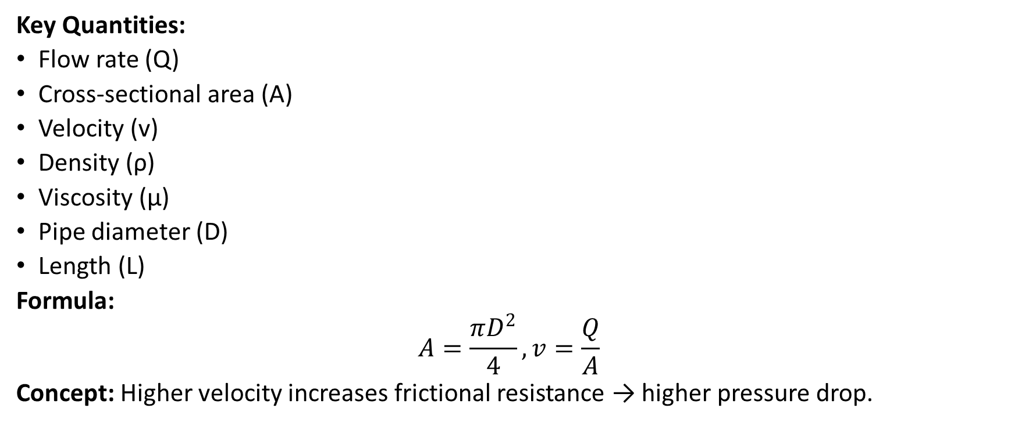
Fluid Transport Fundamentals
Key Quantities:
Flow rate (Q)
Cross-sectional area (A)
Velocity (v)
Density (ρ)
Viscosity (μ)
Pipe diameter (D)
Length (L)
Formula:
$$A=\frac{πD^{2}}{4}, v=\frac{Q}{A}$$
Concept: Higher velocity increases frictional resistance → higher pressure drop.
KAVINRAJA CHAKRAVARTHY
Kavinraja Chakravarthy

Slide 5
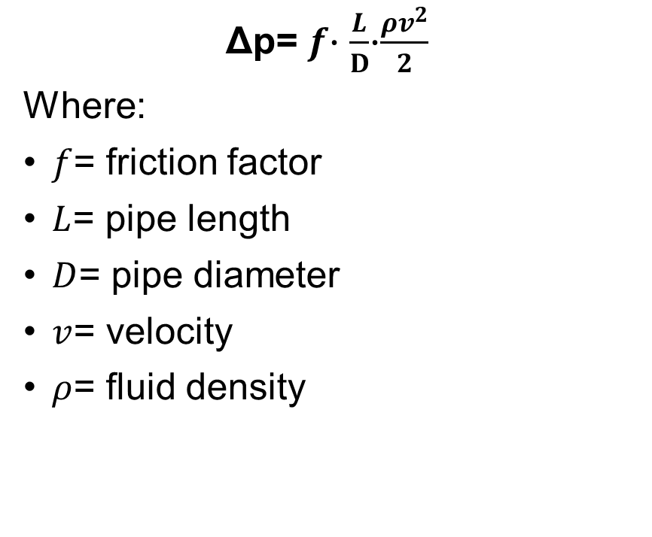
Darcy–Weisbach Equation
Δp= $f$⋅ $\frac{L}{D}$​⋅$\frac{ρv^{2}}{2}$
Where:
$f$= friction factor
$L$= pipe length
$D$= pipe diameter
$v$= velocity
$ρ$= fluid density
Interpretation: Pressure drop is proportional to:
Length
Velocity²
Friction factor
Inversely proportional to diameter
KAVINRAJA CHAKRAVARTHY
Kavinraja Chakravarthy

Slide 6
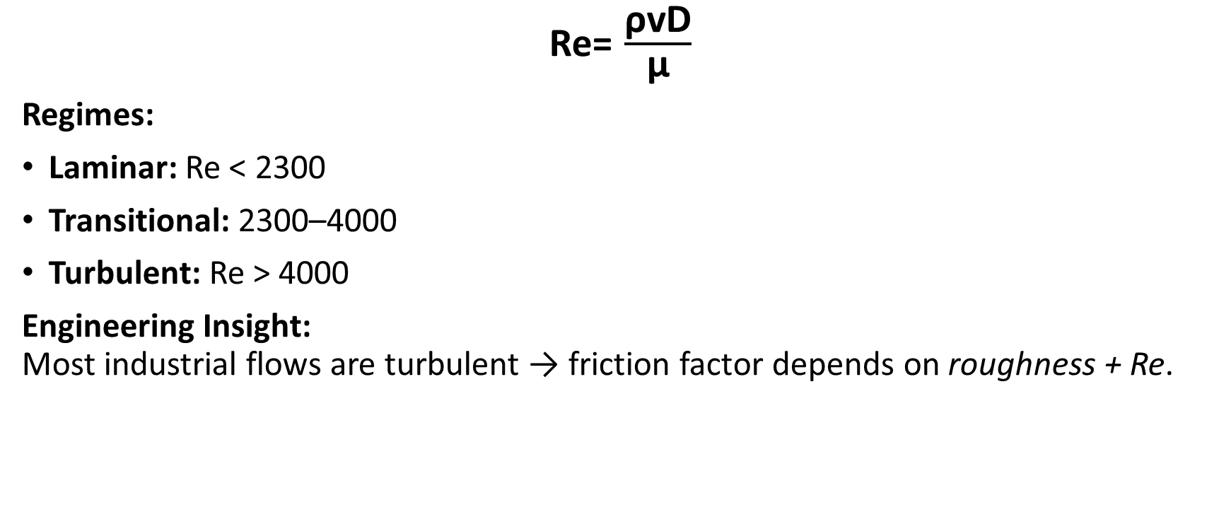
Flow Regimes (Reynolds Number)
Re= $\frac{\text{ρ}\text{vD}}{\text{μ}}$
Regimes:
Laminar: Re < 2300
Transitional: 2300–4000
Turbulent: Re > 4000
Engineering Insight: Most industrial flows are turbulent → friction factor depends on roughness + Re.
KAVINRAJA CHAKRAVARTHY
Kavinraja Chakravarthy

Slide 7
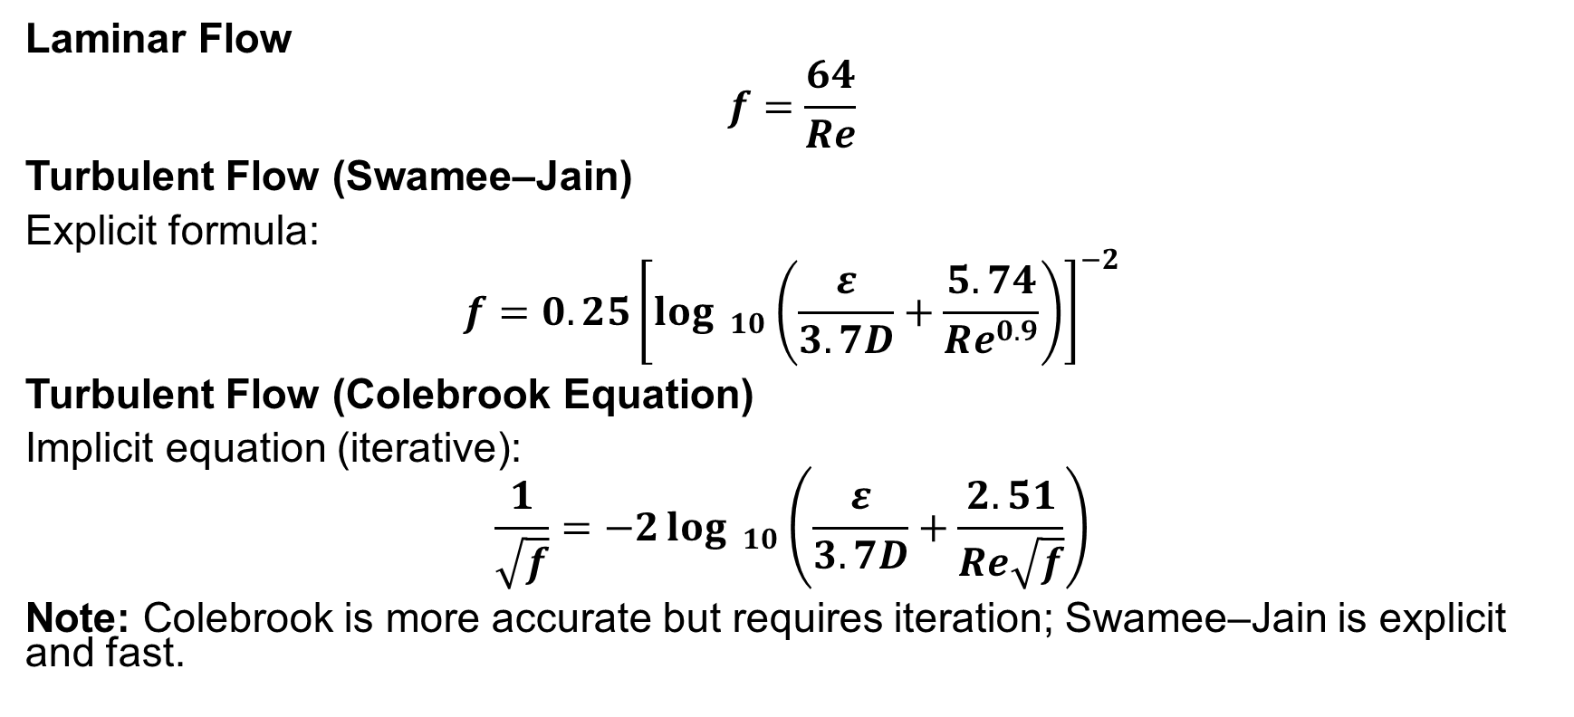
Friction Factor Models
Laminar Flow
$$f=\frac{64}{Re}$$
Turbulent Flow (Swamee–Jain)
Explicit formula:
$$f=0.25{\left[{\log{ }}_{10}\left(\frac{ε}{3.7D}+\frac{5.74}{Re^{0.9}}\right)\right]}^{−2}$$
Turbulent Flow (Colebrook Equation)
Implicit equation (iterative):
$$\frac{1}{\sqrt{f}}=−2{\log{ }}_{10}\left(\frac{ε}{3.7D}+\frac{2.51}{Re\sqrt{f}}\right)$$
Note: Colebrook is more accurate but requires iteration; Swamee–Jain is explicit and fast.
KAVINRAJA CHAKRAVARTHY
Kavinraja Chakravarthy

Slide 8
Pipe Roughness (ε) Values
Material | ε (m) | Notes
PVC | 1.5e-6 | Smooth
Copper | 1.5e-6 | Very smooth
Stainless Steel | 4.5e-5 | Standard engineering value
Commercial Steel | 4.5e-5 | Used widely in industries
Concrete | 3e-3 | Very rough
Importance:
Roughness directly affects turbulent friction → huge impact on pressure drop.
Roughness has negligible effect in laminar flow but significantly increases pressure drop in turbulent flow.
KAVINRAJA CHAKRAVARTHY
Kavinraja Chakravarthy

Slide 9

Minor Losses (K-values)
Δp_{minor}​=K⋅​ $\frac{ρv^{2}}{2}$
Engineer Tip: In short pipelines, minor losses can exceed frictional losses → never ignore.
Component | K-value | Meaning
90° Bend | 0.75 | Change in direction
Gate Valve (open) | 0.15 | Small loss
Sudden Expansion | 1.0 | High loss
Entrance | 0.5 | Sharp-edged entry
KAVINRAJA CHAKRAVARTHY
Kavinraja Chakravarthy

Slide 10
Total Pressure Drop
Δp_{total}​=Δp_{friction}​+Δp_{minor}​
Combine both effects for accurate design.
KAVINRAJA CHAKRAVARTHY
Kavinraja Chakravarthy

Slide 11
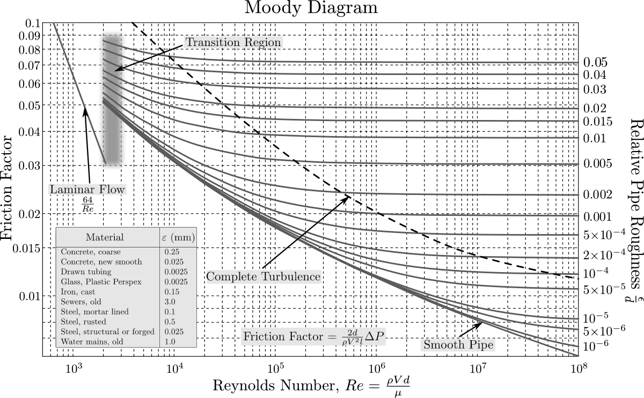
Validation with Moody Chart
KAVINRAJA CHAKRAVARTHY
Kavinraja Chakravarthy

Slide 12
Engineering Algorithm & Computational Workflow(Python,Matlab)
Inputs → Calculations → Outputs
Input: Q, D, L, ρ, μ, ε, K-list
Compute A
Compute v
Compute Re
Determine flow regime
Compute f (laminar / Swamee–Jain / Colebrook)
Compute Δp_{friction}
Compute Δp_{minor}
Output results
KAVINRAJA CHAKRAVARTHY
Kavinraja Chakravarthy

Slide 13
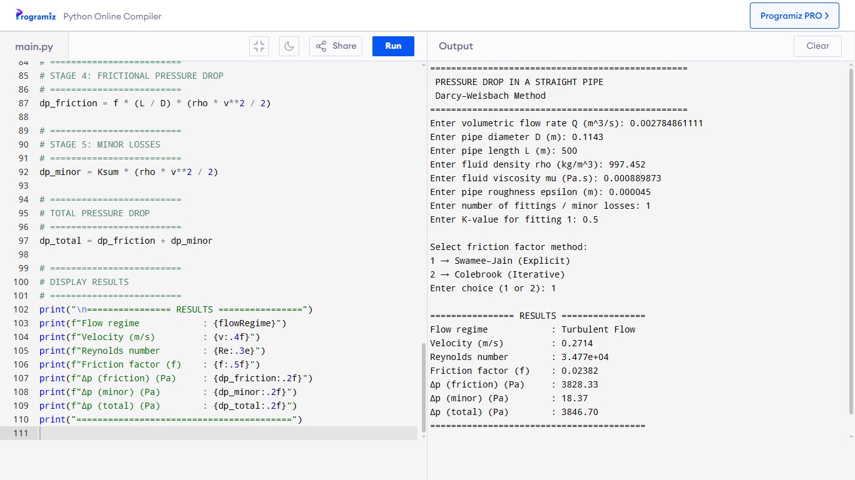
Python Demo Outputs
KAVINRAJA CHAKRAVARTHY
Kavinraja Chakravarthy

Slide 14
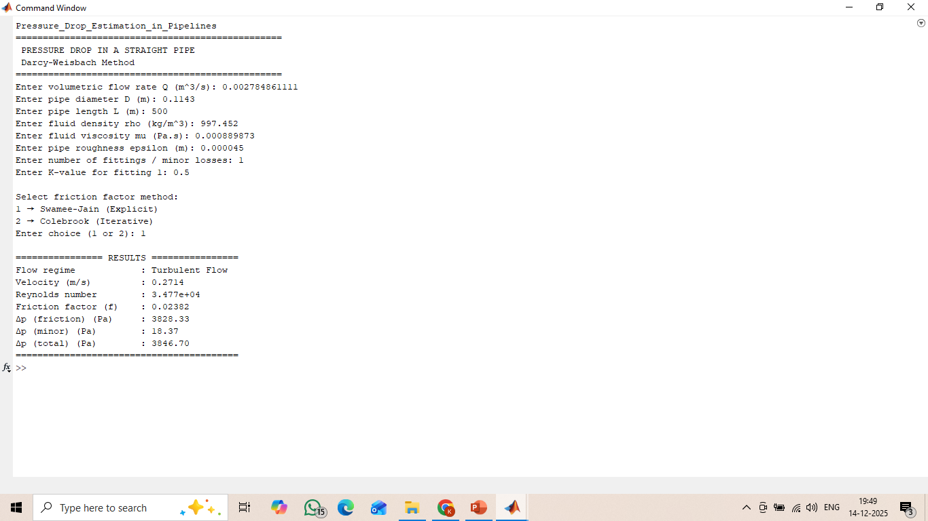
Matlab Demo Outputs
KAVINRAJA CHAKRAVARTHY
Kavinraja Chakravarthy

Slide 15
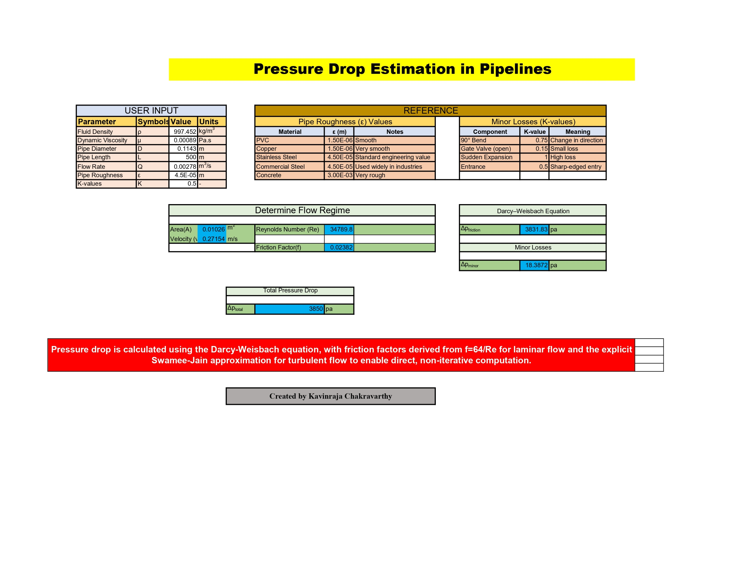
Excel Demo Outputs
KAVINRAJA CHAKRAVARTHY
Kavinraja Chakravarthy

Slide 16
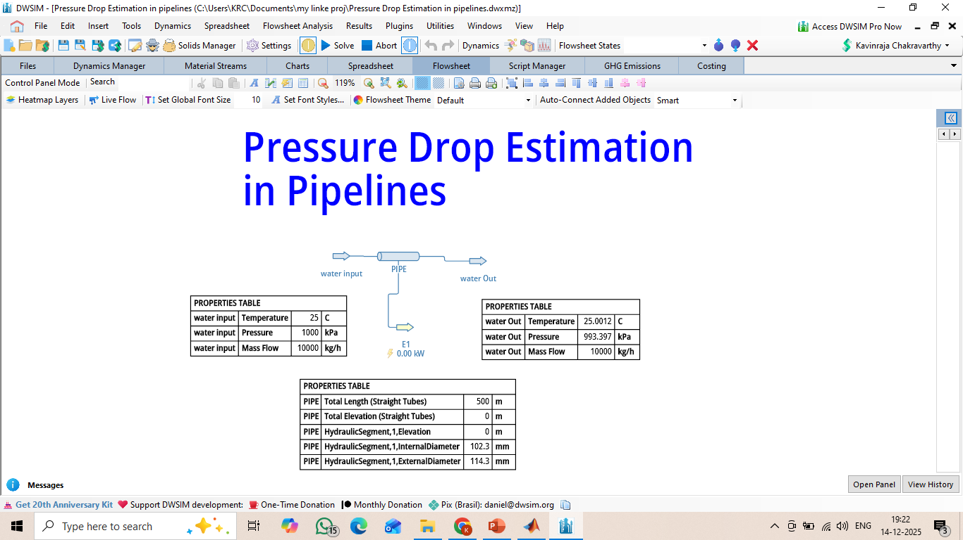
DWSIM Outputs
KAVINRAJA CHAKRAVARTHY
Kavinraja Chakravarthy

Slide 17
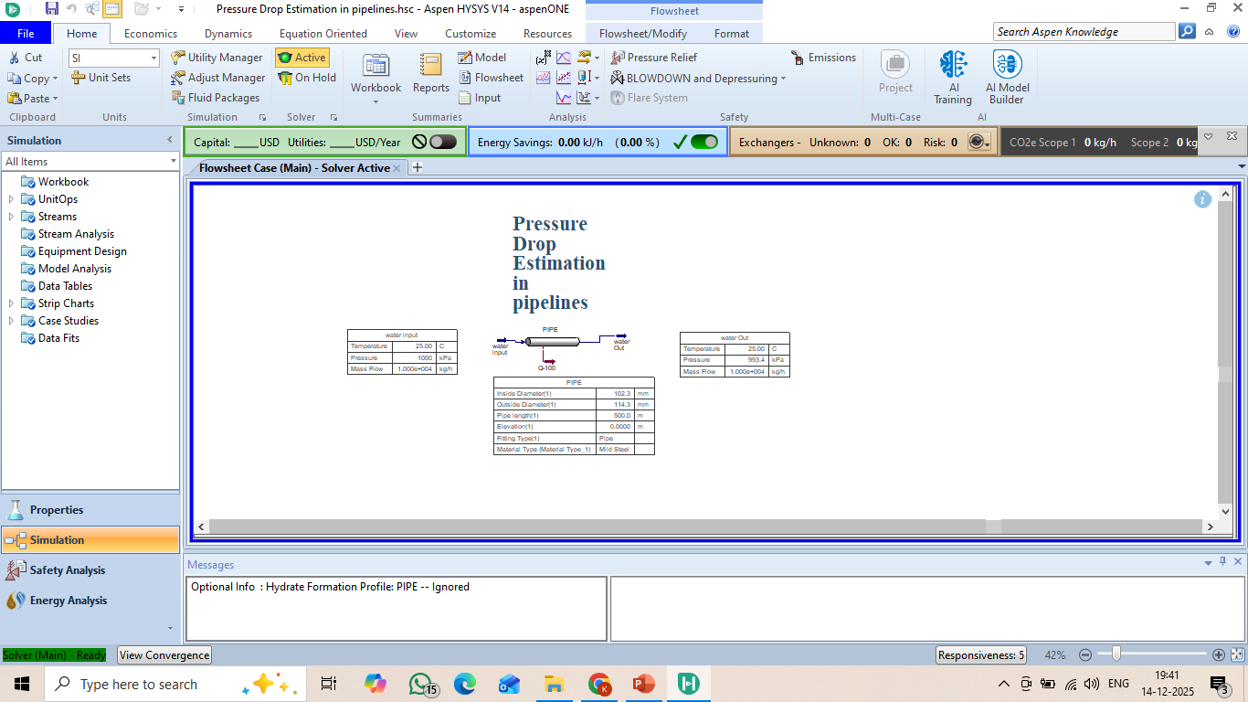
Aspen Hysys Outputs
KAVINRAJA CHAKRAVARTHY
Kavinraja Chakravarthy

Slide 18
Limitations
Assumes incompressible flow
Single pipe only (no network)
No temperature correction for fluid properties
Transitional flow not modeled accurately
Roughness constant (no aging/scaling)
Assumes steady-state, single-phase flow
KAVINRAJA CHAKRAVARTHY
Kavinraja Chakravarthy

Slide 19
Summary
Darcy–Weisbach provides reliable pressure drop estimation
Friction factor selection is critical and regime-dependent
Analytical results were validated using multiple software tools
The project demonstrates strong fundamentals in fluid mechanics and process simulation
KAVINRAJA CHAKRAVARTHY
Kavinraja Chakravarthy

Slide 20
GitHub Repository: https://github.com/kavinrajachakravarthy/Pressure-Drop-Estimation-in-Pipelines
linkedin: https://www.linkedin.com/in/kavinraja-chakravarthy
Thank You
KAVINRAJA CHAKRAVARTHY
Kavinraja Chakravarthy

